Slide 1
Joshua Wu, Summer 2025

Slide 2
Initial directive (5/9/2025):
Get to know the public alphafold3 server by trying co-folding this protein:
https://www.uniprot.org/uniprotkb/P07242/entry#sequences
with a few other Vaccinia proteins.
Try 1 copy vs. 1 copy, then 2 copies vs 2 copies,
Here is a full list of Vaccinia proteins:
https://www.uniprot.org/uniprotkb?query=vaccw
Try the above exercise with anything in the above list with "protein name" including "transcription" or "telomere".
Try some of the "Late transcription" or "intermediate transcription" proteins with each other in a similar exercise, and anything that says "telomere" with each other as a similar exercise.

Slide 3
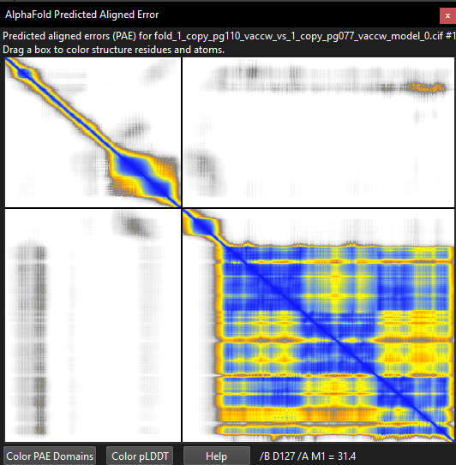
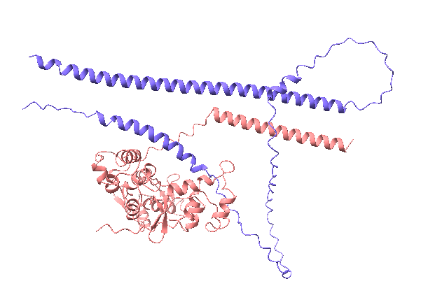
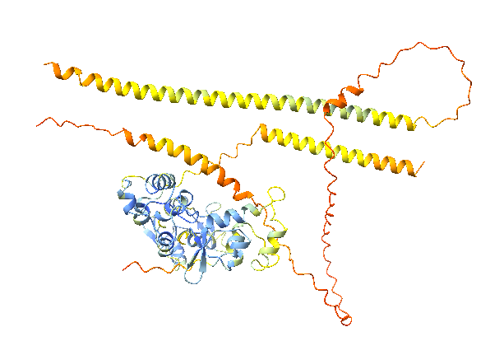
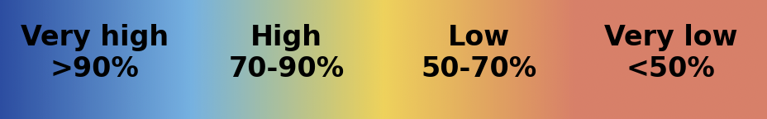
AF3 Model/ChimeraX: 1 Copy PG110_VACCW (Viral late gene transcription factor 4 (VLTF-4)/H5R vs 1 Copy PG077_VACCW(Telomere-binding protein I1/I1L)
Rationale: H5 and I1 seem to be the two most abundant proteins in the virus factory.
IpTM = 0.18
pTM = 0.47
Conclusion: Seems to have low confidence from PAE and pTM, ipTM.

Slide 4
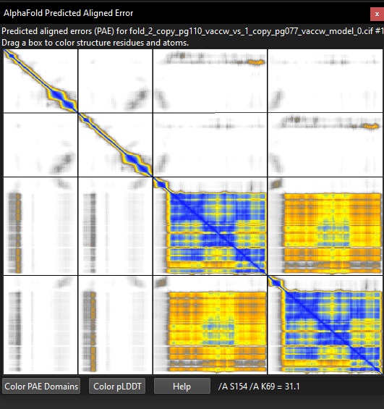
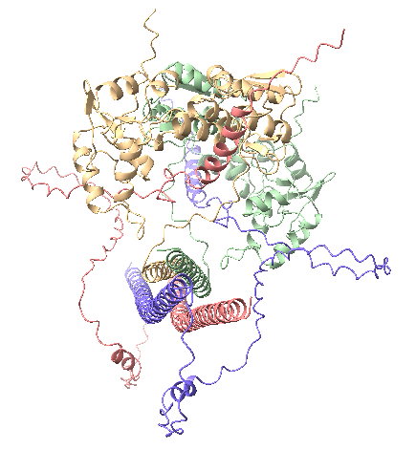
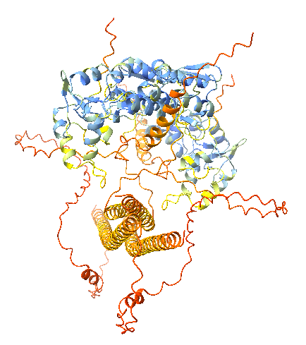
AF3 Model/ChimeraX: 2 Copies PG110_VACCW (Viral late gene transcription factor 4 (VLTF-4)/H5R vs 1 Copy PG077_VACCW(Telomere-binding protein I1/I1L)
Rationale: H5 and I1 seem to be the two most abundant proteins in the virus factory.
ipTM = 0.37
pTM = 0.49
Conclusion: Seems to have low confidence from PAE and pTM, ipTM.

Slide 5
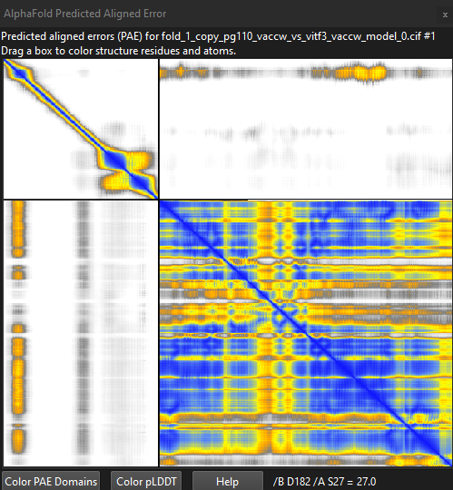
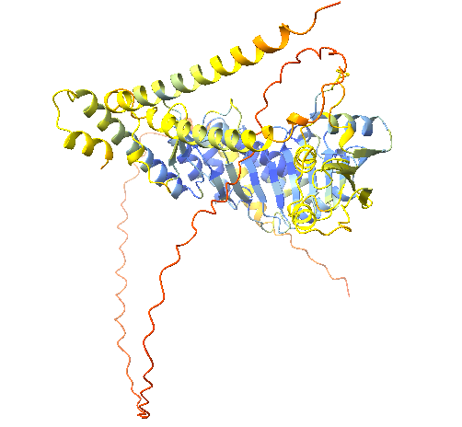
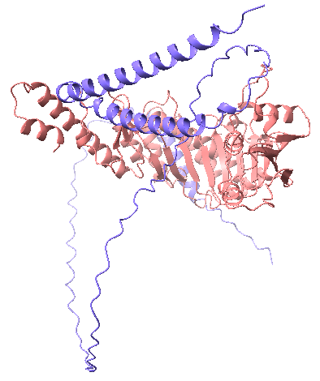
AF3 Model/ChimeraX: 1 Copy PG110_VACCW (Viral late gene transcription factor 4 (VLTF-4)/H5R vs 1 Copy VITF3_VACCW (A23R)
Rationale: According to instructions on slide 2, even though this is VLTF+VITF.
ipTM = 0.29
pTM = 0.59
Conclusion: Seems to have low confidence from PAE and pTM, ipTM.

Slide 6
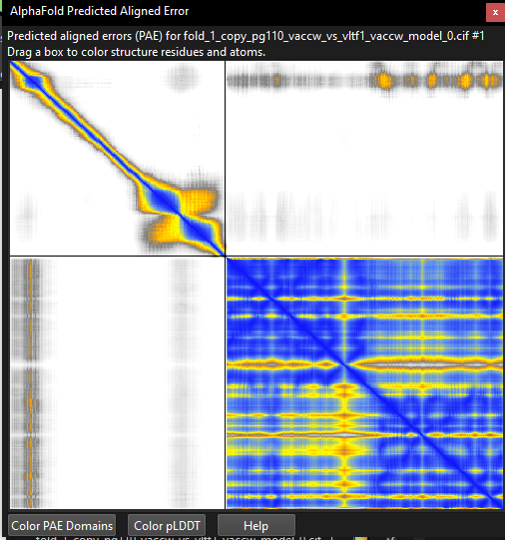
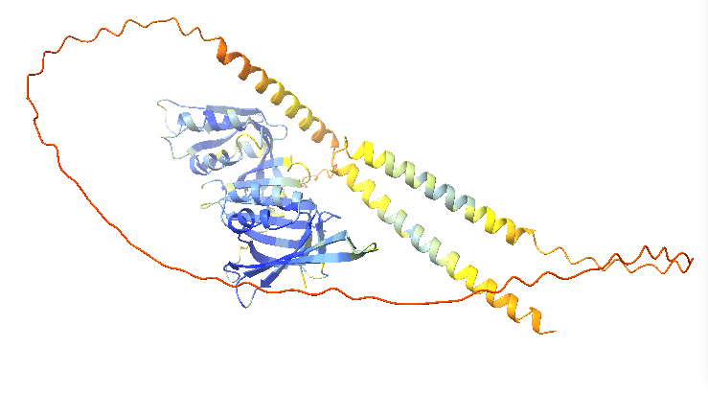
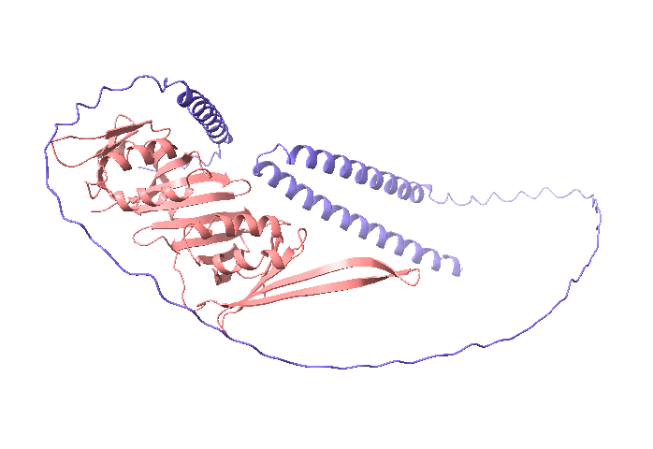
AF3 Model/ChimeraX: 1 Copy PG110_VACCW (Viral late gene transcription factor 4 (VLTF-4)/H5R vs 1 Copy VLTF1_VACCW (G8R)
Rationale: Consistent with instructions on slide 2, even though this is VLTF+VITF.
ipTM = 0.26
pTM = 0.55
Conclusion: Seems to have low confidence from PAE and pTM, ipTM.

Slide 7
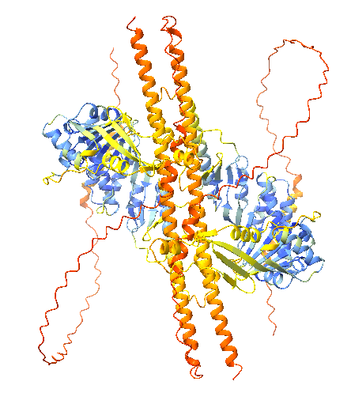
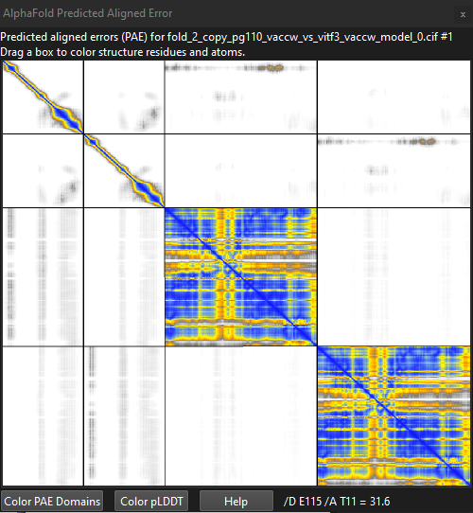
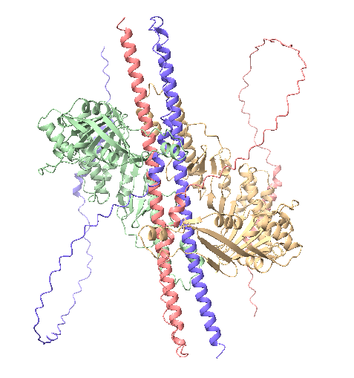
AF3 Model/ChimeraX: 2 Copies PG110_VACCW (Viral late gene transcription factor 4 (VLTF-4)/H5R vs 1 Copy VLTF1_VACCW (G8R)
Rationale: Consistent with instructions on slide 2, even though this is VLTF+VITF.
IpTM = 0.18
pTM = 0.38
Conclusion: Seems to have low confidence from PAE and pTM, ipTM.

Slide 8
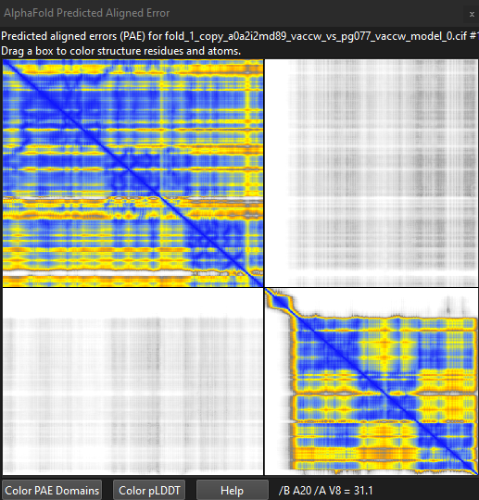
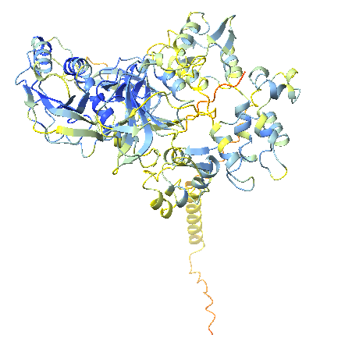
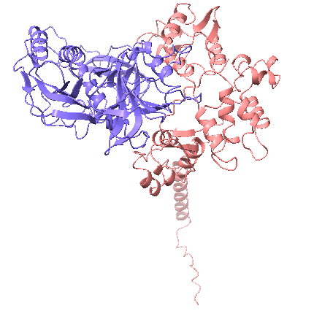
AF3 Model/ChimeraX: 1 Copy A0A2I2MD89_VACCW (Telomere-binding protein I6L) vs PG077_VACCW (Telomere-binding protein I1/I1L)
Rationale: Consistent with instructions on slide 2.
IpTM = 0.19
pTM = 0.58
Conclusion: Seems to have low confidence from PAE and pTM, ipTM.

Slide 9
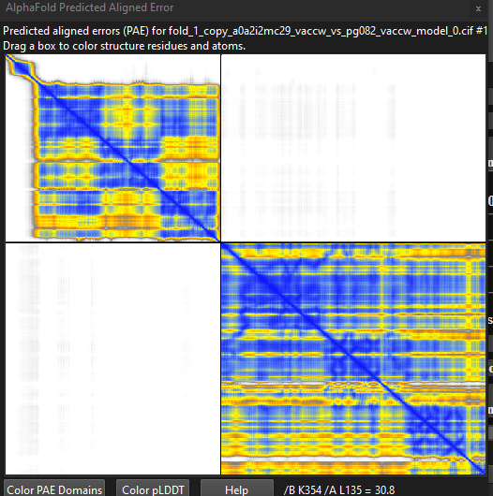
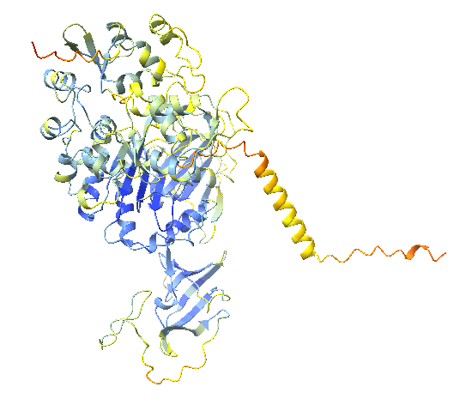
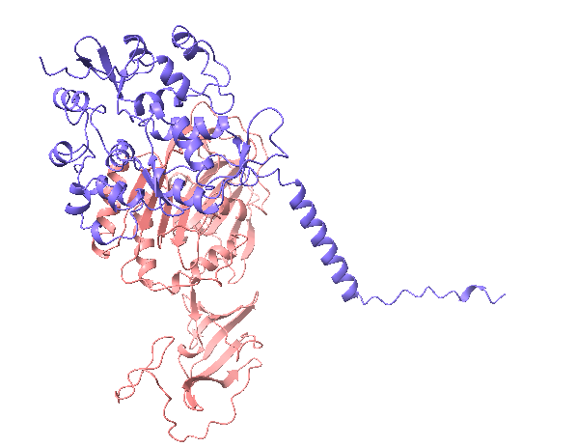
AF3 Model/ChimeraX : 1 Copy A0A2I2MC29_VACCW (I1L) vs PG082_VACCW (Telomere-binding protein I6/I6L)
ipTM = 0.1
pTM = 0.53
Conclusion: Same modeling as prior slide: Sems to have low confidence from PAE and pTM, ipTM.

Slide 10
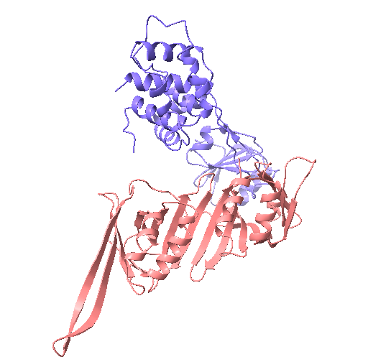
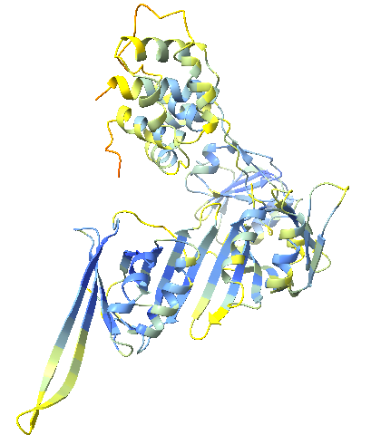
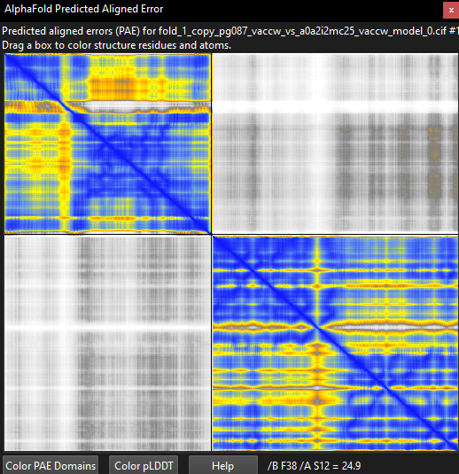
AF3 Model/ChimeraX: 1 Copy PG087_VACCW (Late transcription elongation factor G2) vs A0A2I2MC25_VACCW (VLTF1, G8R)
ipTM = 0.23
pTM = 0.56
Conclusion: Seems to have low confidence from PAE and pTM, ipTM.

Slide 11
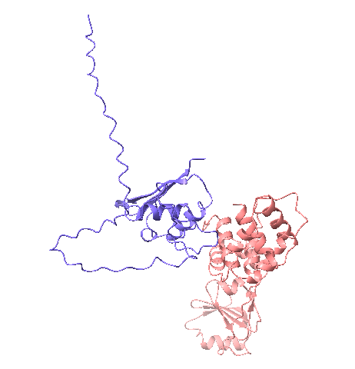
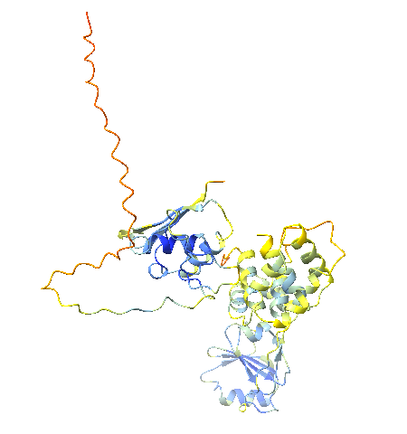
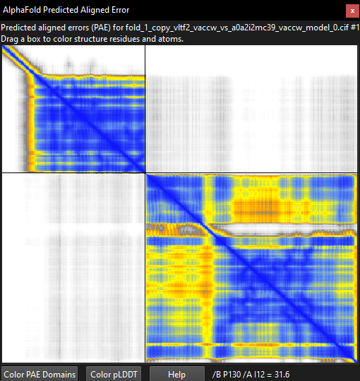
AF3 Model/ChimeraX: 1 copyVLTF2_VACCW (A1L) vs A0A2I2MC39_VACCW (G2R)
ipTM = 0.09
pTM = 0.49
Conclusion: Seems to have low confidence from PAE and pTM, ipTM.

Slide 12
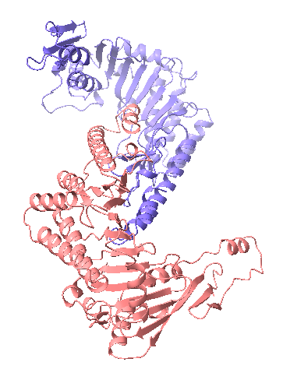
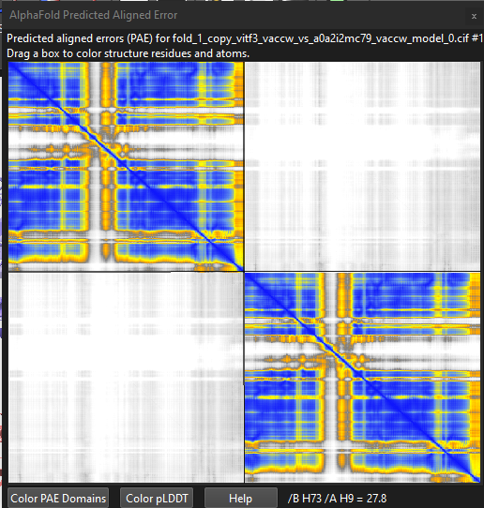
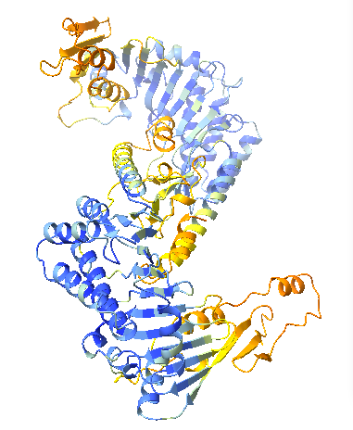
AF3 Model/ChimeraX: 1 Copy VITF3_VACCW (VITF3 large subunit/A23R) vs A0A2I2MC79_VACCW (VITF3 large subunit/A23R). Looks like an attempted homodimer of A23R.
ipTM = 0.15
pTM = 0.48
Conclusion: Unsurprisingly, A23R does not seem to form a homodimer

Slide 13
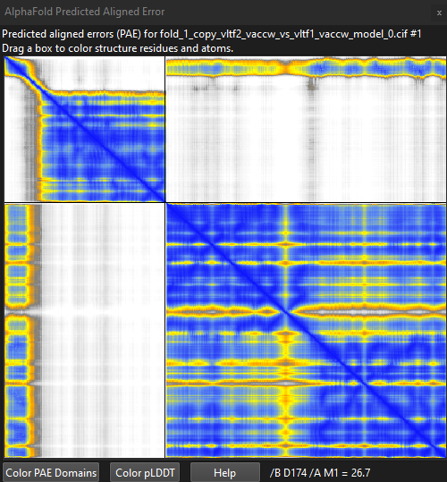
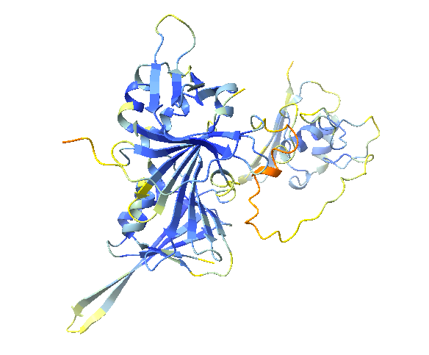
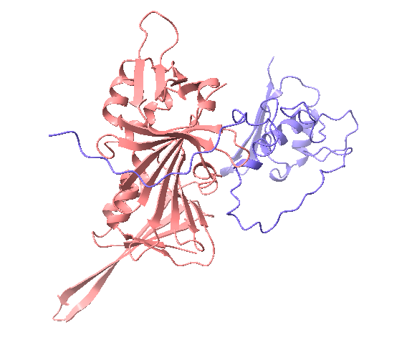
AF3 Model/ChimeraX : 1 Copy each VLTF2_VACCW (A1L) vs VLTF1_VACCW (G8R)
ipTM = 0.7
pTM = 0.63
VLTF1_VACCW
VLTF2_VACCW
Conclusion: Seems to have medium to high confidence from PAE and pTM, ipTM. This is potentially useful, these are two late factors, and both are clearly named as such. You have a potential interaction between the larger chain and the N-terminal domain of the smaller chain (red boxed). Please label the chains above the PAE.

Slide 14
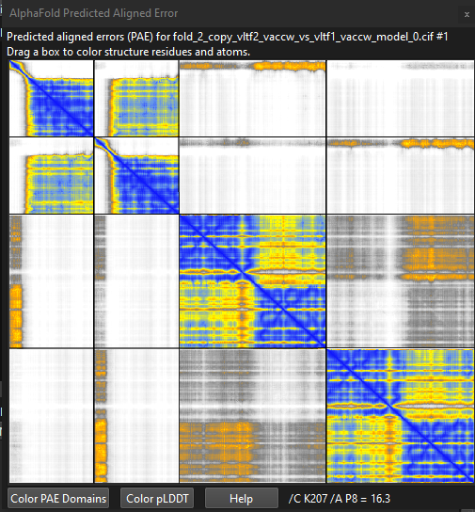
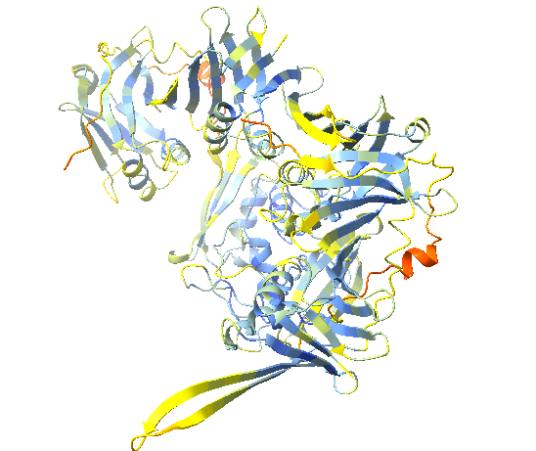
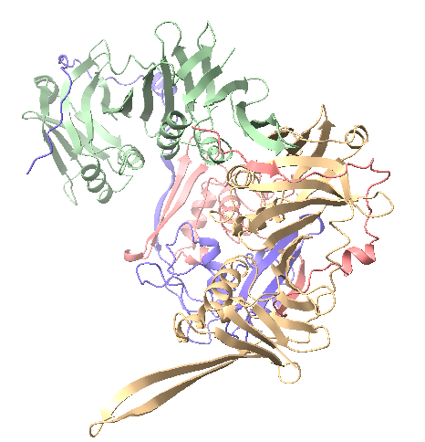
AF3 Model/ChimeraX: 2 Copies each VLTF2_VACCW (A1L) vs VLTF1_VACCW (G8R)
ipTM = 0.29
pTM = 0.59
Conclusions: Seems to have low confidence from PAE and pTM, ipTM.

Slide 15
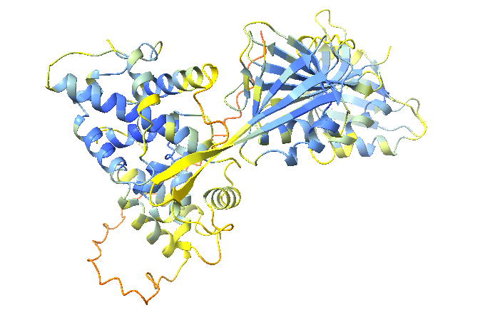
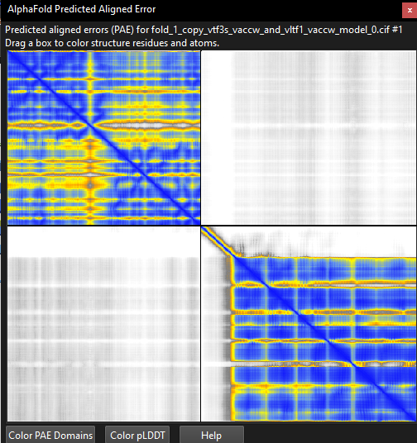
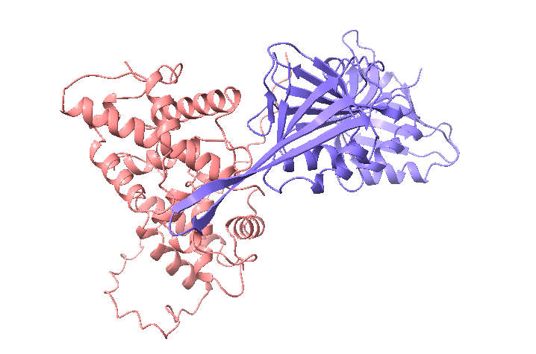
AF3 Model/ChimeraX: 1 copy each VTF3S_VACCW (VITF3 small subunit/ A8R) and VLTF1_VACCW (G8R)
ipTM = 0.16
pTM = 0.49
Conclusions: Seems to have low confidence from PAE and pTM, ipTM.
VITFs and VLTFs are entirely separate and would not be expected to interact.

Slide 16
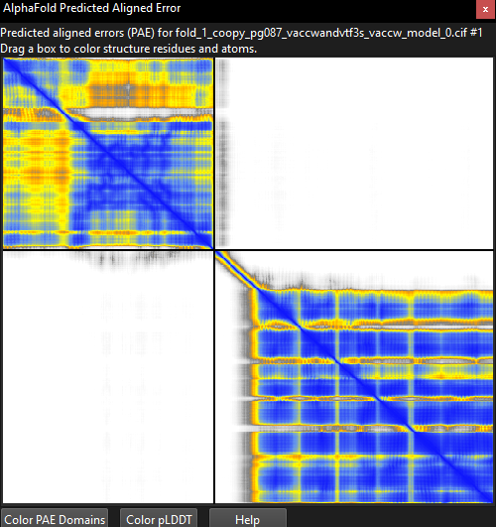
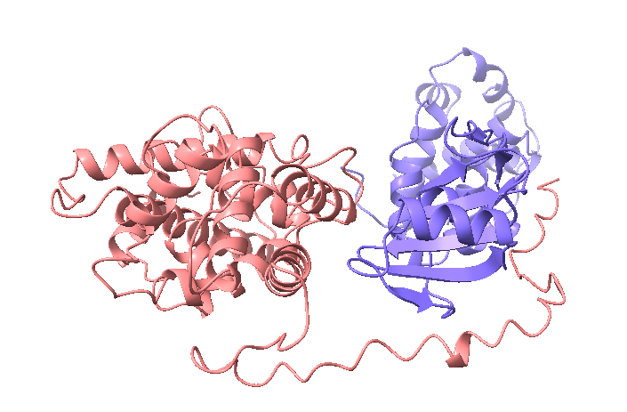
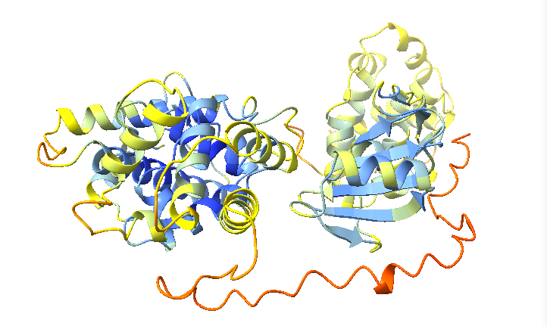
AF3 Model/ChimeraX: 1 Copy PG110_VACCW (VLTF4/H5R) vs VITF3_VACCW (VITF3 large subunit/ A23R).
IpTM = 0.13
pTM = 0.49
Conclusions: Seems to have low confidence from PAE and pTM, ipTM.
VITFs and VLTFs are entirely separate and would not be expected to interact

Slide 17
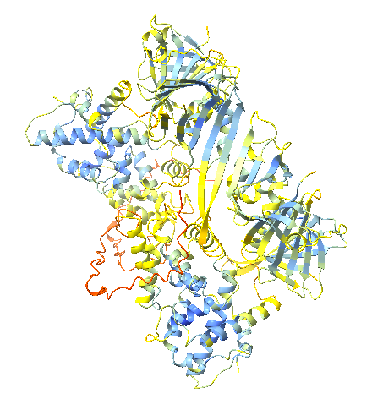
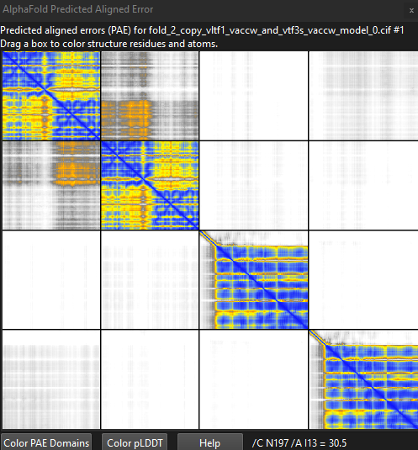
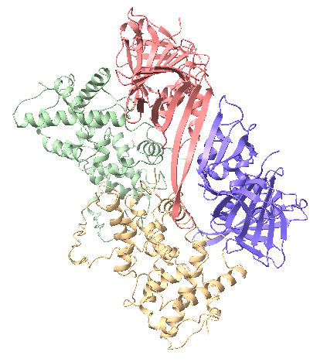
AF3 Model /ChimeraX): 2 copies VLTF1_VACCW (G8R) and 2 copies of VTF3S_VACCW (VITF-3 small subunit/A8R)
ipTM = 0.23
pTM = 0.37
Conclusions: Seems to have low confidence from PAE and pTM, ipTM.
VITFs and VLTFs are entirely separate and would not be expected to interact
Please label the chains above the PAE.

Slide 18
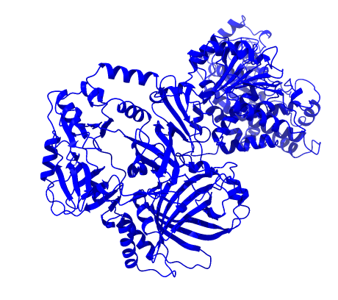
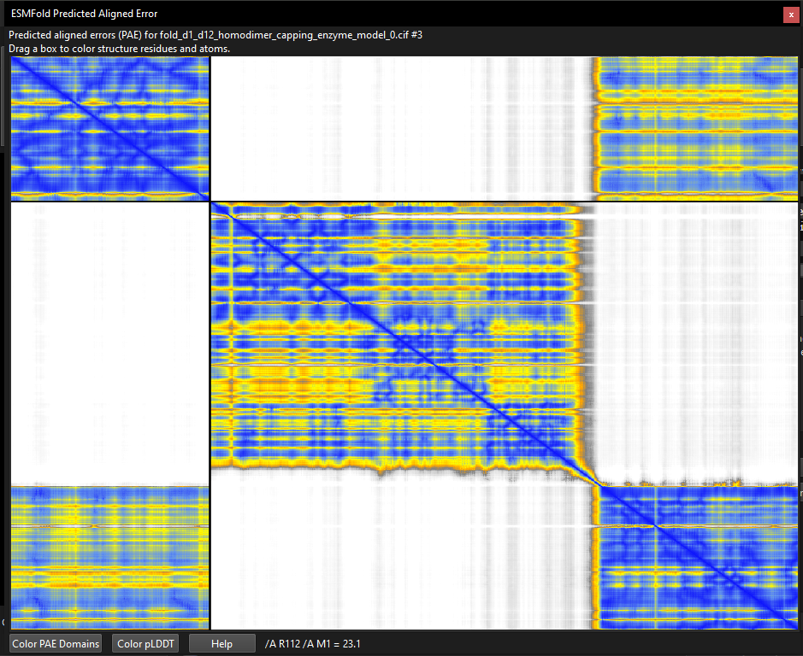
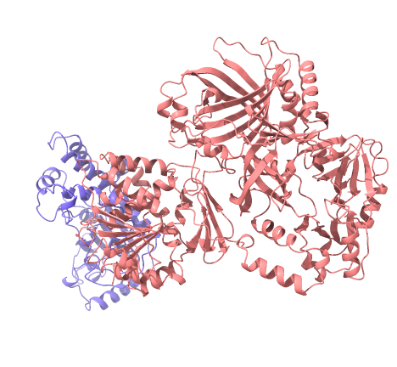
AF3 Model/ChimeraX: 1 Copy MCES_VACCW vs MCEL_VACCW (capping enzyme)
IpTM = 0.89
pTM = 0.54
D1
D12
Conclusion: The homodimer structure is predicted with high confidence, exhibiting strong pLDDT scores throughout, indicating a well-folded complex. The PAE shows consistently low alignment errors across the dimer interface, suggesting a stable interaction, which makes sense as this interaction has been experimentally solved. Please label the chains above the PAE. Why does there appear to be THREE chains in the PAE?

Slide 19
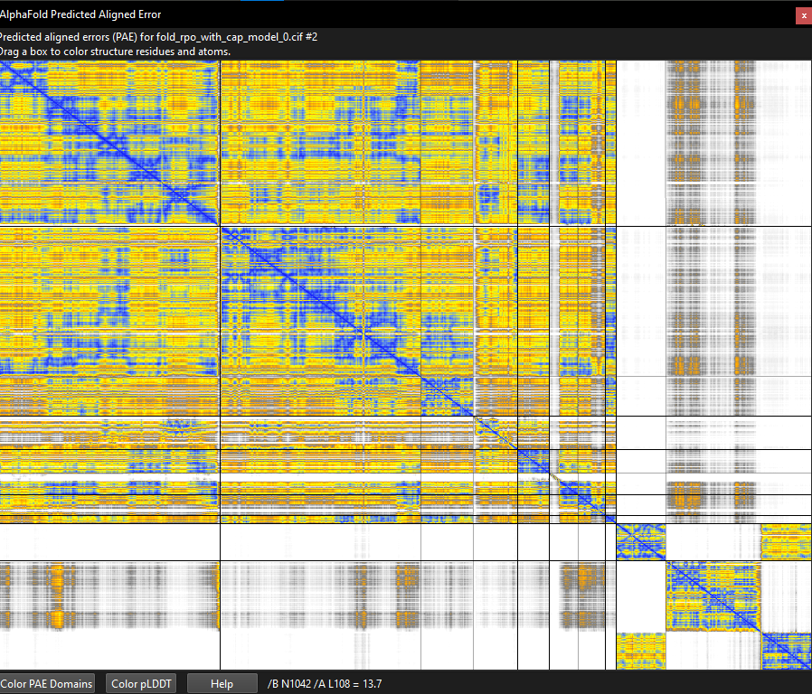


AF3 Model: RNAP (RP147, RP132, RP35, RP30, RP22,RP19, RP18, RP07) with Capping Enzyme
IpTM = 0.77
pTM = 0.78
Capping Enzyme D12
Capping Enzyme D1
Conclusion: pLDDT is high confidence in central domain. The structure exhibits high overall confidence with strong pLDDT scores, indicating a well-folded complex. The PAE shows low alignment errors across most regions, suggesting stable interactions. No, the PAE shows no confidence in D1/D12 interactions with each other, or with RNAP. Why? Because this structure is solved: https://www.rcsb.org/structure/6RIE Why does there appear to be THREE chains for D1/D12 in the PAE?

Slide 20



AF3 Model: PAP1_VACCW with MCE_VACCW
Analysis: The complex displays high-confidence folding with consistently strong pLDDT scores across both chains. The PAE plot shows uniformly low alignment errors throughout the interface, indicating stable and well-defined interactions between the protein components. No significant high-PAE regions are present, suggesting a rigid and biologically plausible complex structure with minimal flexibility..
IpTM = 0.89
pTM = 0.54
Heterodimer PAP1_VACCW
MCE_VACCW

Slide 21

ChimeraX Model: PAP1_VACCW & MCE_VACCW complex + RNAP (RP147, RP132, RP35, RP30, RP22,RP19, RP18, RP07) with capping enzyme
Note: I tried to combine RPO and the PAP1_VACCW & MCE_VACCW complex in AF3, but it wasn’t working (12 proteins). I put them both in ChimeraX, but am not too sure on how to interpret or analyze their interaction.
Heterodimer PAP1_VACCW
MCE_VACCW

Slide 22



AF3 Model: RNAP (RP147, RP132, RP35, RP30, RP22,RP19, RP18, RP07) with RAP94_VACCW
Analysis: The Rpo complex with Rap94 exhibits high overall confidence, with strong pLDDT scores indicating well-folded domains. The PAE plot shows predominantly low alignment errors, suggesting stable interactions between the components. The IPTM and PTM also suggest the possibility of a binary interaction.
IpTM = 0.9
pTM = 0.91
RAP94_VACCW

Slide 23



AF3 Model (on ChimeraX): RPO missing RP147 subunit with Cap folded with MCE_VACCW and PAP1 complex
Analysis: Seems to have medium confidence from PAE and pTM, ipTM. I could not show it as cartoon on ChimeraX and I found this problem for all that involved RPO.
ipTM = 0.51
pTM = 0.54

Slide 24



AF3 Model (on ChimeraX): RNAP (RP147, RP132, RP35, RP30, RP22,RP19, RP18, RP07) with RAP94_VACCW and TOP1_VACCW
Analysis: Seems to have high confidence from PAE and pTM, ipTM.
ipTM = 0.85
pTM = 0.86

Slide 25



AF3 Model (on ChimeraX): RNAP (RP147, RP132, RP35, RP30, RP22,RP19, RP18, RP07) with RAP94_VACCW and NPH2_VACCW
Analysis: Seems to have high confidence from PAE and pTM, ipTM.
ipTM = 0.81
pTM = 0.83

Slide 26



AF3 Model (on ChimeraX): RNAP (RP147, RP132, RP35, RP30, RP22,RP19, RP18, RP07) with RAP94_VACCW and L3_VACCW
Analysis: Seems to have high confidence from PAE and pTM, ipTM.
ipTM = 0.84
pTM = 0.86

Slide 27



AF3 Model (on ChimeraX): RNAP (RP147, RP132, RP35, RP30, RP22,RP19, RP18, RP07) with RAP94_VACCW and PAP1_VACCW
Analysis: Seems to have high confidence from PAE and pTM, ipTM.
ipTM = 0.82
pTM = 0.84

Slide 28



AF3 Model (on ChimeraX): RNAP (RP147, RP132, RP35, RP30, RP22,RP19, RP18, RP07) with RAP94_VACCW and NTP1_VACCW
Analysis: Seems to have high confidence from PAE and pTM, ipTM.
ipTM = 0.89
pTM = 0.9

Slide 29



AF3 Model (on ChimeraX): RNAP (RP147, RP132, RP35, RP30, RP22,RP19, RP18, RP07) with RAP94_VACCW and I6_VACCW
Analysis: Seems to have high confidence from PAE and pTM, ipTM.
ipTM = 0.83
pTM = 0.85
I6_VACCW

Slide 30



AF3 Model (on ChimeraX): NPH2_VACCW & NTP1_VACCW & L3_VACCW Nucleoside triphosphatase II (NTPase II)/I8R & Nucleoside triphosphate phosphohydrolase I (NPH I)/D11L & Protein L3/L3L
Reason added: June 24 email said to try combinations of these proteins
ipTM = 0.17
pTM = 0.45

Slide 31



AF3 Model (on ChimeraX): I6_VACCW & L3_VACCW Telomere-binding protein I6/I6L & Protein L3/L3L
Reason added: June 24 email said to try combinations of these proteins
ipTM = 0.28
pTM = 0.6

Slide 32



AF3 Model (on ChimeraX): L3_VACCW and NTP1_VACCW Nucleoside triphosphate phosphohydrolase I (NPH I)/D11L Telomere-binding protein I6/I6L & Protein L3/L3L
Reason added: Could not add these with RPO + RAP 94 (maybe this is useful?)
ipTM = 0.34
pTM = 0.61

